Slide 1

This Experiment Was Created Using

Slide 2






Instructions
In this experiment, you will be placed into a 3D environment and your task is to find and collect the following items as fast as you can! To collect an item simply walk into it. When you collect and item you will hear the item’s sound.
Chomp!
Cha-ching!
Gulp!

Slide 3
Find Both!

Slide 4

MOVEMENT CONTROLS
To navigate the environment, use the Up-Arrow to move forward, the Down-Arrow to move backwards and the Left-Arrow and Right-Arrow to rotate.
Move Forward
Rotate
Left
Rotate
Right
Move Backward

Slide 5
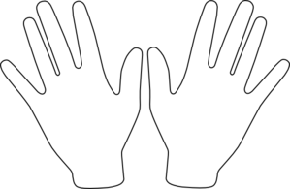
Get Ready!
Spacebar
Place your right hand on the arrow keys and press the Spacebar with your left to continue!

Slide 7
Collect the Items!

Slide 8
Find

Slide 9
Find

Slide 10
Find

Slide 11
You’ve Completed the Experiment! Press the button at the top of the editor to end the experiment.

Slide 12
Locate the Cube!! Note: Sometimes it will be invisible!

